Slide 1
SecureHouse: A Home Security System Based on
Smartphone Sensors

Slide 2
proposed method
To design ML and threshold based methods to detect door opening events based on accelerometer and magnometer
send sms/email/call to owner.
accuracy’accelerometer 98%
magnetometer 100%
iphone 4 can detect keystroke on keyboard with 80% accuracy.

Slide 3
Motivation
Home security importance
Feasable
Reuse old phones
Existing home security systems avl but at high cost (installation + annual charge)

Slide 4
Existing work
Barometer
air pressure
prob open window
2 video streaming apps like manything presence etc
Problem
Low light unable to detect motion
High end camera required
storage for video

Slide 5
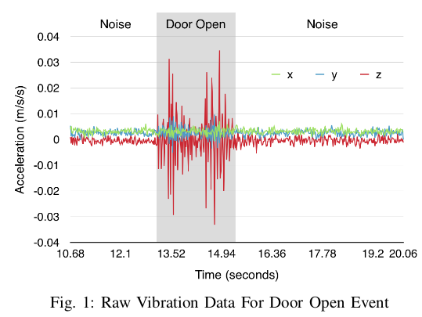
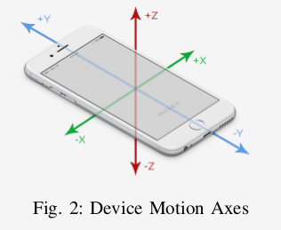
Accelerometer Sensor Sample
mounted on wall near door.

